Slide 1
COVID-19 Vaccine uptake in migrants, refugees and asylum seekers Professor Esperanza Diaz Head of Pandemic Center, University of Bergen, Norway https://www.uib.no/pandemi
Her kan du skrive enhet/tilhørighet. Sett blank hvis dette ikke er aktuelt. Innhold i dette feltet styres her: Meny -> Vis -> Topptekst og bunntekst
WEBINAR: COVID-19 Vaccination Uptake among Migrants & Ethnic Minorities: Challenges & Opportunities

Slide 2
COVID-19 Vaccine uptake in migrants… one step back, one step forward
What we knew before COVID-19
Preparedness & situation today
COVID-19 priorities and migrants
Uptake
Barriers
Short and long term solutions
Pandemic and migration: an opportunity?

Slide 3
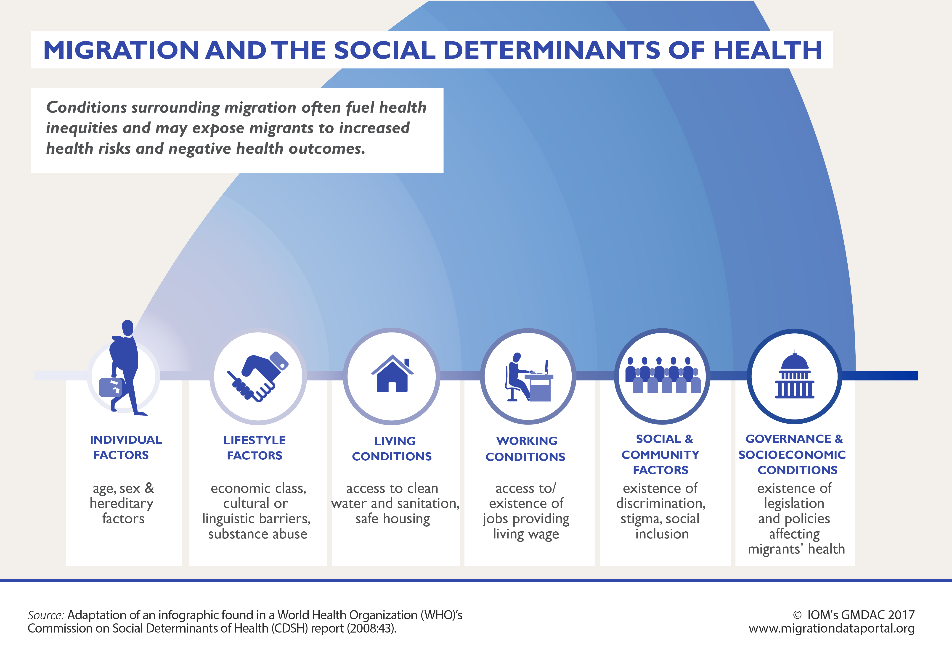
What we knew: Migrants before COVID-19
Risk factors for infectious diseases
Biological & epidemiological
Social & legal
Migration specific
Low levels of vaccine coverage
Charania, N. A., Gaze, N., Kung, J. Y., & Brooks, S. (2019). Vaccine-preventable diseases and immunisation coverage among migrants and non-migrants worldwide: A scoping review of published literature, 2006 to 2016. Vaccine, 37.

Slide 4
What we knew: Migrants & vaccination H1N1
Black respondents - more likely to express reservations about the safety and efficacy of the H1N1 vaccine
Rates of H1N1 vaccination:
White females: 28.4%
White males: 26.3%
Black males: 21.6%
Black females: 17.5%
Differences in health beliefs, SES, pre-existing conditions, and healthcare explained lower odds of H1N1 vaccination.
Intersectional nature of associations: Black women 35–45% lower odds than white women
Black-white disparities in 2009 H1N1 vaccination among adults in theUnited States: A cautionary tale for the COVID-19 pandemic. Vaccine, 39, 43-951. Burger, A. E., Reither, E. N., Mamelund, S.-E., & Lim, S. (2021).

Slide 5
Preparedness for “a” pandemic
Target: Biological risk factors only
Some describe social and migrant determinants as risk factors, but do not target them (except language I some cases)
Why?
Wishful-thinking: mortality behind us, mild pandemic, long time intervals…
“Dangerous” pandemics only happen in LIC (Ebola++)
Priority is only “for LIC”
Migrant health does not have a real consequence for health for all

Slide 6
Situation today: not surprising news…

Slide 7
NHS England: Generally, high levels of willingness to take up the vaccine, but
91% of all recipients - white people
People of mixed ethnicity (33%), Asian (47%) and black (64%) as likely to receive the vaccine as white people

Slide 8
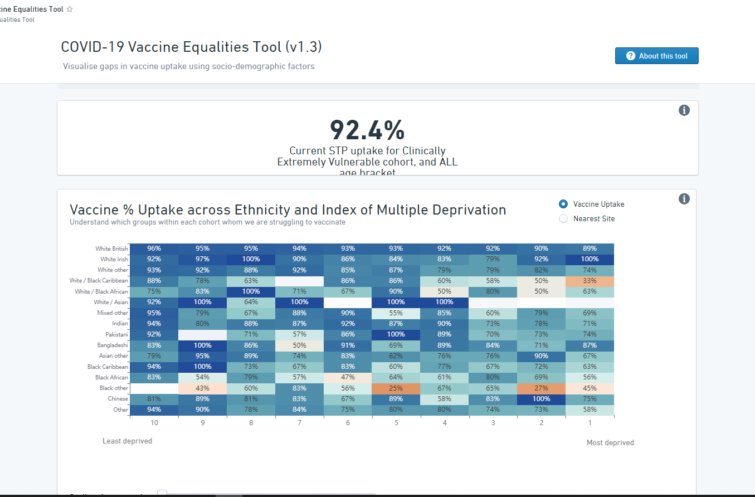
Hampshire and Isle Of Wight Vaccination Programme UK NHS Ethnicity & Multiple deprivation in CEV (all ages) (06/03/21)

Slide 9
But context dependent

Slide 10
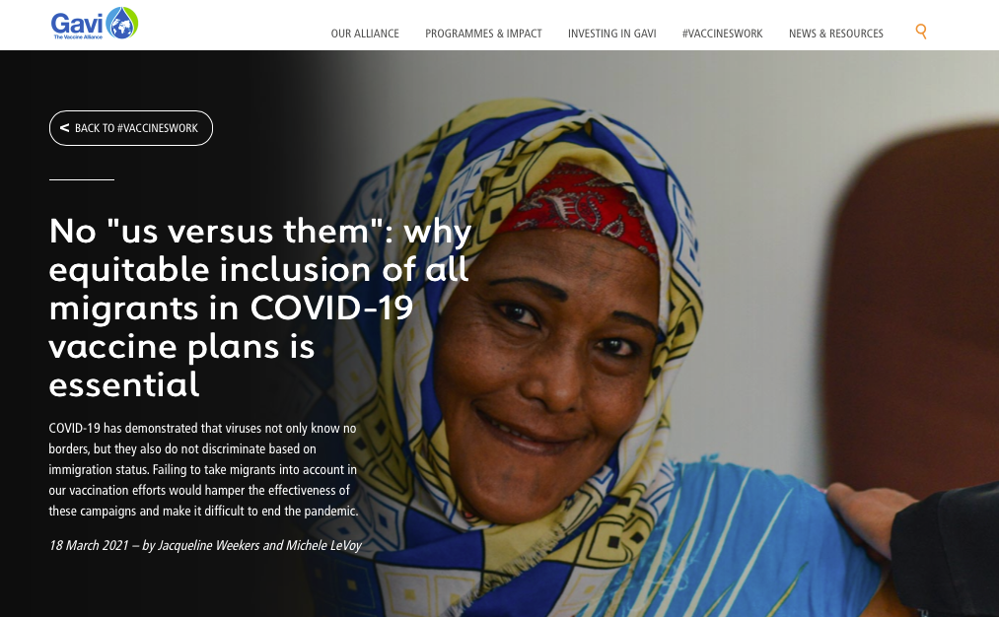
Vaccine priorities: global view
International frameworks and priorities (COVAX)…
But do nationalisms triumph global health (despite risk of contagious)?
National vulnerable populations
What is “national”?
How to ”sell” this to societies without stigmatising?

Slide 11
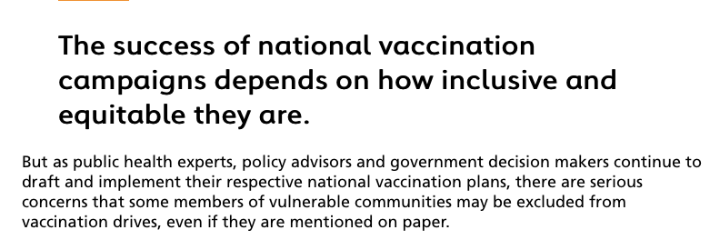
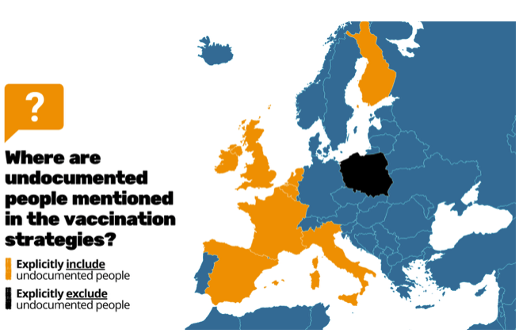
National implementation policies
Priorities:
Age: discriminatory factor for migrants? (who become sick 10-15 years earlier)
Indirect priority making: areas with high levels of disease, ”vulnerable groups”, etc
Some migrant groups excluded /non mentioned

Slide 12
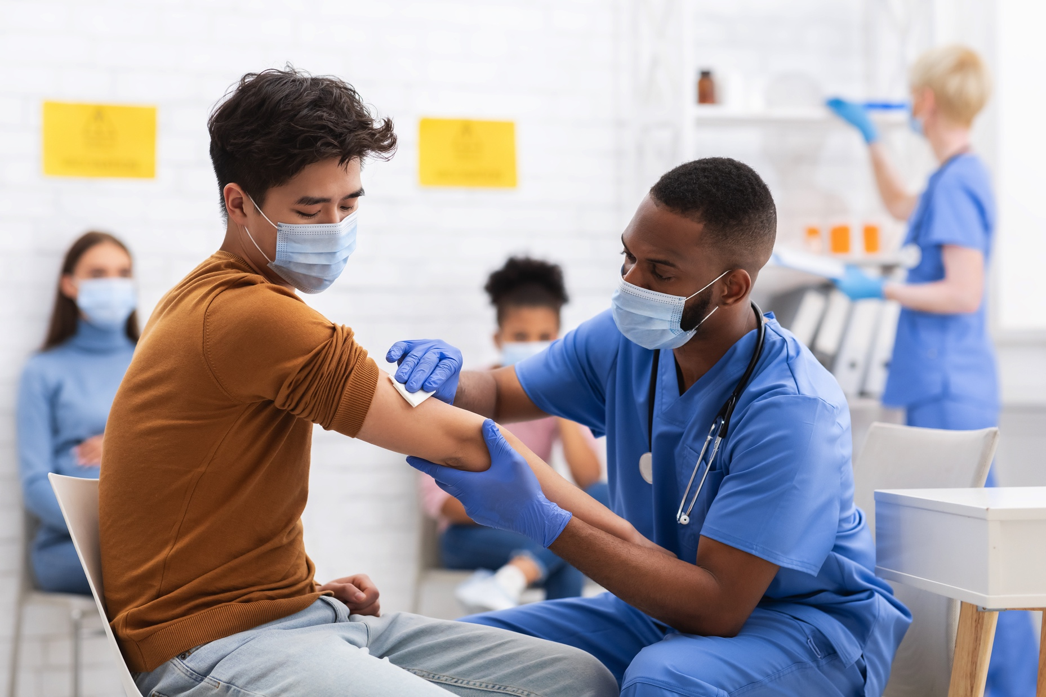
Barriers to vaccine uptake: when ”my turn” really comes…
Health care system Personal Societal

Slide 13
Barriers to vaccine uptake
Context dependent
History and current systems set the stage
Hesitancy is not equal to denying or being against vacination

Slide 14
Structural barriers to vaccine uptake
No (few) long lasting national/local migrant strategy
No (few) specific priority in the pandemic
Data on migration background
No real time, systematic data
No homogeneity
No professionalised communication strategies: high risk of stigmatising and blaming
Not (enough) culturally competent workforce for mainstreaming
Structural racism
Vaccine research: Migrants less represented at all levels
Researchers and health leaders
Data
Lower inclusion rates (hard to reach??)
Infections and vaccines: “Historical “testing” (“as guinea pigs”)

Slide 15
Barriers to vaccine uptake: sociodemographic & health access
Insurance, coverage
Inconvenience - economic consequences of being vaccinated
Lack of communication from trusted health care providers
Previous health care experience
Lack of vaccine offer (structural discrimination (emails at hospitals), intersectionality)

Slide 16
Barriers to vaccine uptake: Information and trust
Language literacy – most targeted
Low trust/ confidence in health authorities and the vaccine
Perception of risk, side effects, efficacy (“Non halal”,…)
Family/community endorsement
Transcultural lifes: Mismatch between countries and settings
Earlier experience with management of crisis: Polish- Chernobyl 1986
Social Media more important
More disinformation
Understanding misinformation: From “Digital pass” to “an implanted chip”
Real mistrust: conspiracy theories, negative views of doctors

Slide 17
Barriers to vaccine uptake: communication and society
Information on migrants and COVID-19 through (social) media
Economic downturn: negative public discourse on migrants
Simplification of associations: vicious circles
migrant= non compliance=danger=non-wanted
”You are from Somalia, I wil take another taxi”

Slide 18
Solutions at local level: mostly ad-hoc?
Translation of (majority oriented) information + specific information (religious+)
Outsourcing to minority communities, champions
Enabling environments (mosques)
Practical/economical support to meet disadvantage through vaccine uptake
…
Sharing practical solutions
Transparent and regular reporting of progress
Partnership: community representation in the workforce, leadership and decision making levels.
Add migration, race and ethnicity to public dashboards
Use of resources: (Not yet accredited) migrant health professionals into health care systems ++
…
Evaluation of interventions

Slide 19
A portfolio of innovation
Sustaining – improve the situation
Disruptive – test new ”crazy” ideas
Transformative - long term strategy infrastructure
Use the ”pandemic momentum”
OBS- What helps now might be the wrong long-term solution
Second class delivery of information?
Not mainstreaming cultural competence?
Need to evaluate - need for data….

Slide 20
Pandemic and migration
COVID-19 vulnerabilities: an extrapolation of already existing vulnerabilities exacerbated in the context of the pandemic
The data is now needed not only to prove which new approaches work, but to manage and improve its performance
The pandemic as an opportunity to show the need for disruptive and transformative innovation for migration and health
https://www.h3uni.org/practices/foresight-three-horizons/

