Slide 1
COVID19 Vaccine Recs and Migrant Relevance
Cochrane-GRADE-GIN Covid Rec Map
https://covid19.recmap.org/
Kevin Pottie MD MClSc
Professor, Department of Family Medicine and Epidemilogy and Community Medicine, Clinical Investigator Bruyere Research Insitute and Insitut Saviour Montfort
University of Ottawa

Slide 2
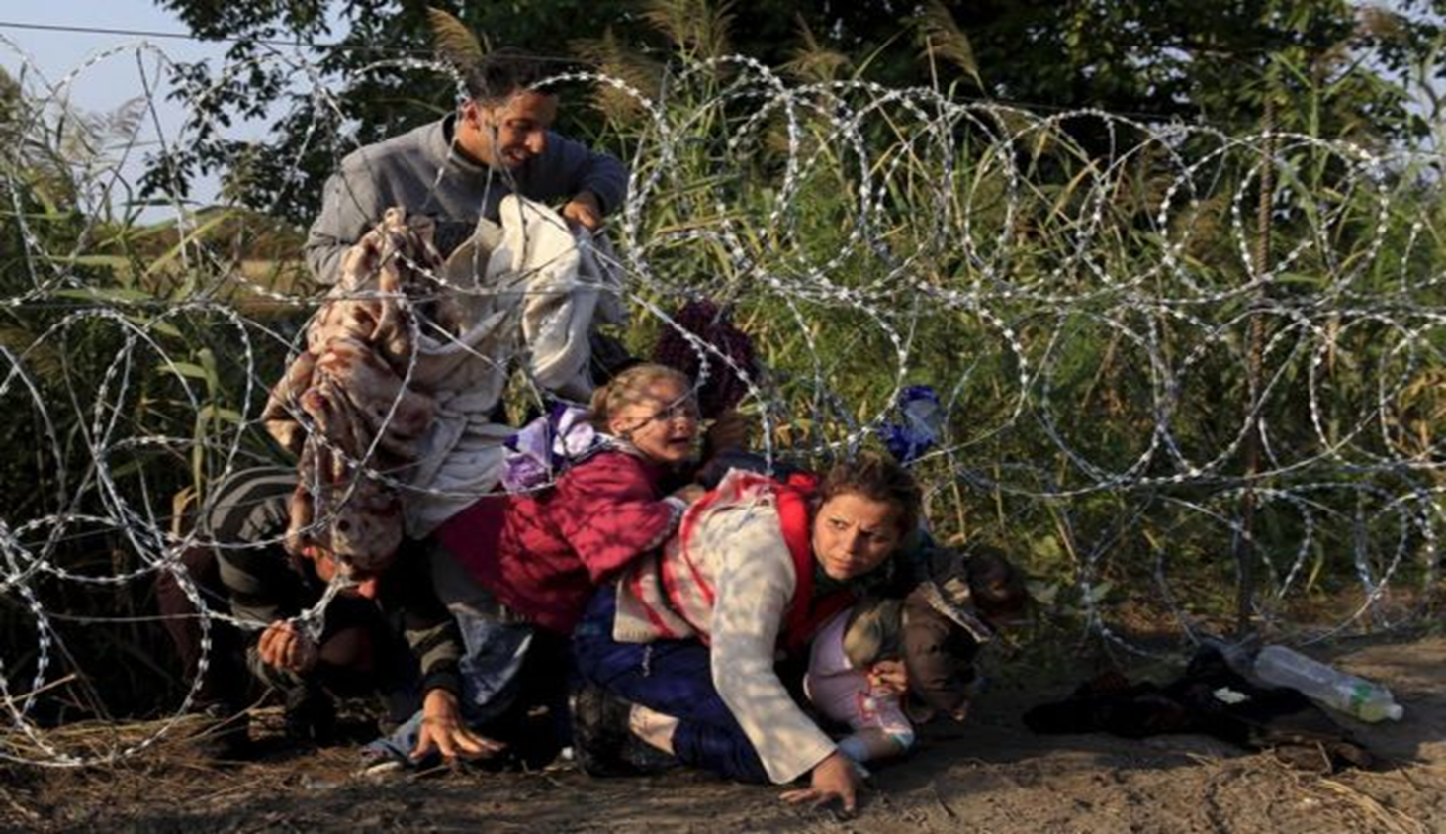
Migrants and the COVID19 Pandemic
Resilience amidst epidemics and structural inequities
Isolation (language, culture, COVID19 restrictions)- creates beliefs, rumours, mistrust
Beliefs are community coping mechanisms in times of uncertainty
Stigma creates mistrust and reluctance for testing, vaccines (ie HIV, Ebola)
PhotoCredit UNHCR 2015

Slide 3
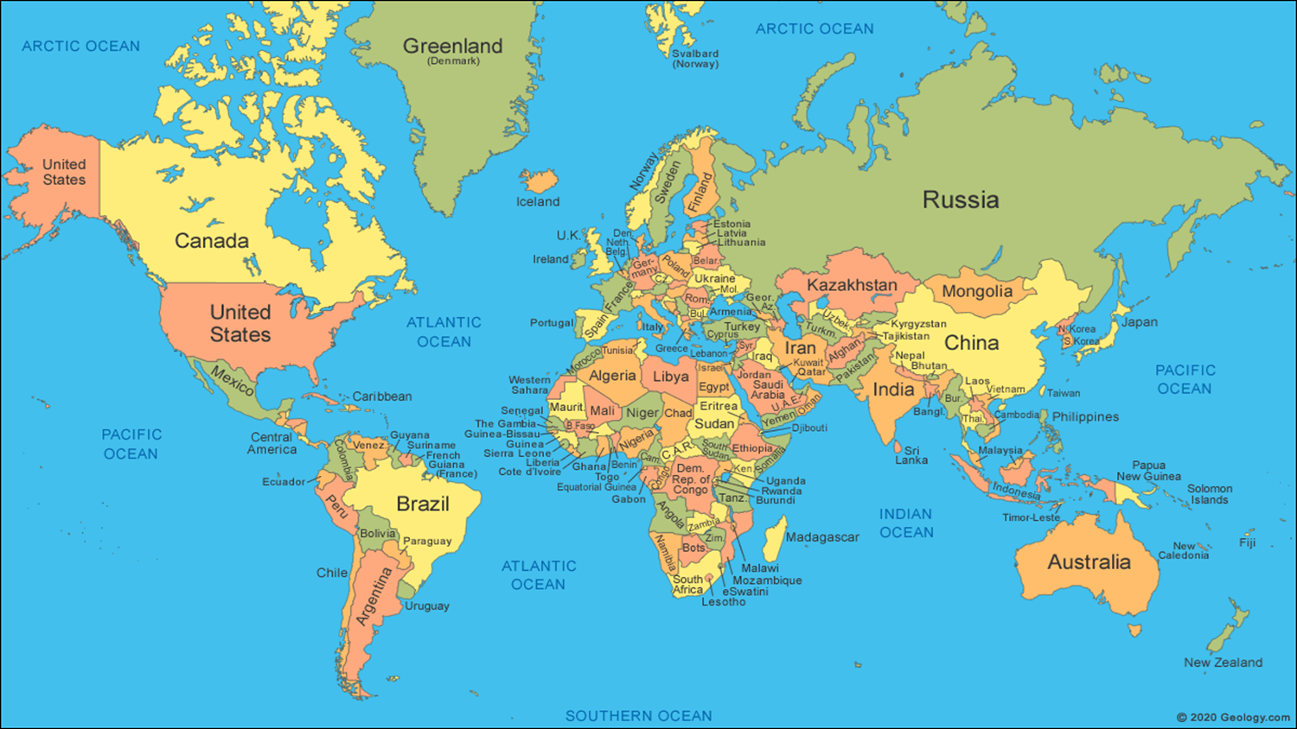
Vaccines as a Health Equity Intervention
Protecting families, elders
Ensuring fair access to jobs, income, pharmacies and other healthcare
Rights to fight back against COVID19 racism and discrimination
Facilitating travel and access to families abroad

Slide 4
COVID19 Recs Vaccine Plain Language Summary
Should people older than 16 years of age receive the Pfizer-BioNTech vaccine to prevent COVID19?
Recommendation: The World Health Organization recommends the Pfizer-BioNTech vaccine to prevent COVID19 in people over 16
Who is the recommendation for?
You are 16 years of age and older
You are the parent, guardian, or caregiver of a person who is over 16 years of age or older
You do not have an active case of COVID19

Slide 5
eCOVID19 PLS cont…
Recommendation strength: Conditional
A recommendation can be strong or conditional
When a recommendation is strong, most people will want to follow it
When a recommendation is conditional, the majority of people want to follow it but may need more discussion with their healthcare professional first
Why Conditional?
This recommendation is conditional because the overall benefits of getting the two doses of the vaccine are probably greater than the not getting vaccinated.
Additional Information:
The vaccine includes two shots in the arm, three weeks apart. However, because vaccine creation and distribution is slow, the second shot could be delayed without impacting the vaccine effect.

Slide 6
eCOVID19 PLS cont…
The consequences of COVID19 vaccine are greater among:
The elderly
People with chronic health conditions such as diabetes and hypertension
People living in high density settings, such as refugee camps, detention centres
Because of the limited supply of the Pfizer- BioNTech vaccine, international travelers should not be prioritized to receive it.
Benefits: 95% effective at preventing COVID19 disease; reduces COVID19 illness, hospitalizations and death
Harms: Vaccine cannot cause COVID infection or disease. Common harms are limited to normal immune response side effects including sore arm, mild fever and possible fatigue.

Slide 7
eCOVID19 PLS cont…
What does this mean for you?
What you can do:
Talk to your health care professional and discuss whether you can (or someone under your care) should receive the Pfizer- BioNTech vaccine
Speak with your healthcare professional to:
Discuss any concerns you or your community may have about receiving the vaccine. And because there are more than one vaccine against COVID19, discuss key differences*
See *eCOVID19 commentary on vaccines.

Slide 8
eCOVID Plain Language Vaccine Commentary
All of the COVID vaccines: Pfizer-BioNTech, Moderna, Johnson & Johnson and AstraZeneca prevent COVID19 infection, hospitalization and death with high level of certainty.
It is difficult to compare the efficacy of the 4 different vaccines because of differences in the original research studies. For example, there are differences in the original characteristics of the test populations, the presence or absence of virus variants during the studies, and a variation in dosing regimens.
Now, after more than 20 millions doses of vaccine have been given, we have real world effectiveness result from several countries including Britain and Israel (Lancet 2021). These ‘big data’ observational results show the vaccines have similar effectiveness after single doses, similar common minor side effects and only rare (less than 10 events per million) risk of serious side effects. See eCOVID rec maps for more details.

Slide 9
COVID-19 Vaccines
Vaccine | Doses | Measure of Efficacy | Efficacy % | Key Differences
Pfizer- BioNTech | 2 | COVID symptoms from 7 days after second dose | 95 | Trial mostly in US, before resistant variants
Moderna | 2 | COVID symptoms 14 days after the second dose | 94 | Trial in US before resistant variants
Johnson and Johnson | 1 | Severe COVID symptoms from 28 days after send dose | 85 | One dose, trial included Brazil and South Africa resistant variants
AstraZeneca- Oxford | 2 | COVID symptoms from 14 days after the second dose | 82 | Trial included Brazil and South Africa resistant variants
The Economist Mar 6, 2021

Slide 10
Vaccines Reduce infections, hospitalizations and death (Estimates after 20 million doses given in Britain and Israel)
10,000 unvaccinated
80 deaths
270 hospitalizations
7800 treated at home
1850 asymptomatic
10,000 vaccinated (1 dose Pfizer-BioNTech)
13 deaths*
180 hospitalizations*
2,574 treated at home*
610 asymptomatic*
*estimates
Dagan et al, 2021

Slide 11
Mass-Vaccination Data (England, over 70yrs )
Pfizer-BioNTech ------ AstraZenca-Oxford ------ Lancet March 3, 2021

Slide 12
Key Messages

Slide 13
FACE Instrument for Local Relevance
The World Health Organization recommends the new “Pfizer- BioNTech” vaccine to prevent COVID-19 for people aged 16 years and older.
Is the recommendation topic a priority for you or your community?
Is the recommendation feasible for you or your community?
Is the recommendation acceptable for you or your community?
Are the out of pocket costs/time commitment high for you or your community?
Would the recommendation be fair for your community?
Final question: Do you intent to use or follow the recommendation?

Slide 14
Thank you! Merci! Gracias! Questions?
eCOVID Rec Map
https://covid19.recmap.org/
RottenCarrots.com™
Send people to our site for e-learning recommendations

