Slide 1
COVID-19 Vaccination of Refugees and Migrants
Jozef Bartovic, WHO Regional Office for Europe

Slide 2
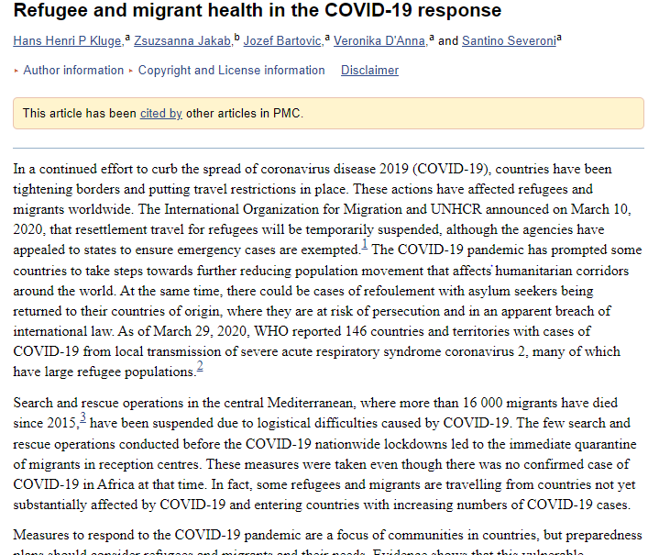
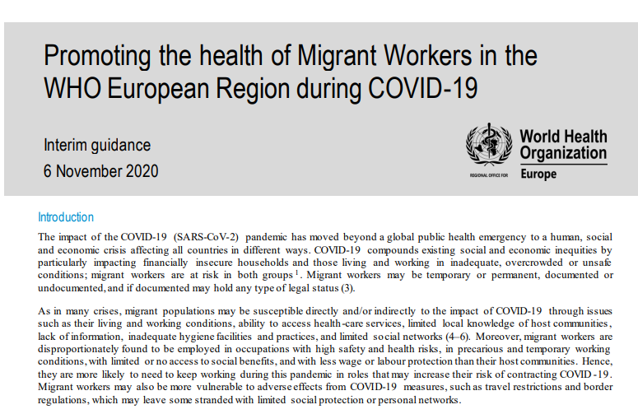
Impact of the pandemic

Slide 3
Technical Guidance Series
Aim: To inform and provide technical guidance or advice to policymakers and decision-makers
This technical guidance outlines three critical elements for ensuring high levels of vaccination coverage among refugees and migrants:
 provision of appropriate vaccination services to newly arrived refugees and migrants;
 delivery of immunization services for refugees and migrants as part of mainstream health services; and
 provision of targeted and culturally appropriate immunization services to reach refugees and migrants.

Slide 4
TG: Delivery of immunization services for refugees and migrants
Member States are encouraged to consider the following key policy options with a view to ensuring the equitable provision of immunization services to refugees and migrants including addressing barriers to vaccination service delivery and utilization:
 ensure national immunization programmes (NIPs) take into consideration humanitarian events or crises and health system capacity is adequate;
 consider occupational risk factors and ensure vaccination where needed, particularly for those working in migration centres or crisis situations;
 strengthen the capacity of primary care providers to identify opportunities for vaccination among refugees and migrants;
 expand vaccination to wider age groups to increase opportunities to ensure vaccination coverage of refugees and migrants;
Notes:
Services are supplied and they may be both needed and supplied but not demanded
services can be needed. But neither demanded nor supplied;

Slide 5
TG: Delivery of immunization services for refugees and migrants
Member States are encouraged to consider the following key policy options with a view to ensuring the equitable provision of immunization services to refugees and migrants including addressing barriers to vaccination service delivery and utilization:
 establish or upgrade immunization information systems (IIS) to capture vaccination coverage data for refugees and migrants;
 consider using intensified targeted initiatives to augment vaccination coverage among underserved refugees and migrants;
 identify barriers, enablers and behavioural factors determining vaccination uptake among refugees and migrants, and develop tailored approaches, including communication and advocacy strategies; and
 improve training and awareness of health-care practitioners on the needs and cultural and social perspectives of refugees and migrants.
Notes:
Services are supplied and they may be both needed and supplied but not demanded
services can be needed. But neither demanded nor supplied;

Slide 6
COVID-19: WHO guidance and key resources
Strategic considerations in preparing for deployment of COVID-19 vaccine and vaccination in the WHO European Region, 9 October 2020
SAGE advisory prioritization road map
Interim position paper: considerations regarding proof of COVID-19 vaccination for international travelers
Ethical consideration for immunity certificates
IHR Annex 6 and 7
Notes:
Stage 2 – 11 – 20 %
Sociodemographic groups at significantly higher risk of severe disease or death (depending on country context, examples may include: disadvantaged or persecuted ethnic, racial, gender, and religious groups and sexual minorities; people living with disabilities; people living in extreme poverty, homeless and those living in informal settlements or urban slums; low-income migrant workers; refugees, internally displaced persons, asylum seekers, populations in conflict settings or those affected by humanitarian emergen
Vaciination passports/ records - good idea but should not be used to restrict liberties/ freed of movement
Legal, data, ethical issues
IHR annex 6 and 7 states what should be included
Only vaccine is yellow fever

Slide 7
WHO EURO Region
Raising awareness – SAGE advisory, guidance, etc.
Better understanding of what is happening on the ground
EURO region examples from NVDPs: Uzbekistan, Tajikistan – incl refugees; Tajikistan - IDPs
Not just about equitable access, making the right conditions for vaccine uptake
Humanitarian buffer - populations in humanitarian settings that are not covered in national vaccine deployment plans
Monitoring of situation & support countries to include r&ms, guidance & COs

Slide 8
Country examples: Serbia
Serbia
National Institute of Public Health starting campaign of immunization in camps
Vaccinate all refugees staying in camps – no time limit on stay so incl. transiting refugees
Proof of vaccination will be issued
Materials to share info on vaccination, comms training foe health professionals
Task force – UN agencies, ministries & other stakeholders
Greece
Task force & national collaboration
Mapping for underlying condition – on par with local population
Provision to meet the needs – transport to vaccination centers, translators, cultural mediators, etc.

Slide 9
Thank you
WHO Regional Office for Europe
UN City Marmorvej 51 Copenhagen Ø Denmark
WHO_Europe facebook.com/WHOEurope instagram.com/whoeurope youtube.com/user/whoeuro
Migration and Health Programme, Office of the Regional Director of Europe

