Slide 1
Opportunities & Challenges for Covid 19 vaccination in migrants settled in canada

Slide 2
Conflict of interest
None

Slide 3
Objectives
1
Understand migration in the Canadian context
2
Understand the health context in Alberta
3
Understand the challenges for vaccination of migrants in Canada
4
Understand the opportunities for vaccination of migrants in Canada

Slide 4
Who Are Regular Migrants to Canada?
341,180
Permanent Migrants
6,581,876
Temporary Migrants
196,658
Economic Immigrants
91,311
Family Class Immigrants
5,774,342
Visitors
402,427
Student Visa
48,530
Refugees and Protected Person
4,681
Other Humanitarian
405,107
Temporary Workers
*some temporary migrants may become asylum-seekers once in Canada
Notes:
There are 2 broad categories of regular migrants: permanent and temporary.
There are 3 basic classes of permanent residents: economic, family, and refugees.
Visitors = tourists + business travelers who require visas or electronic travel authorization
Temporary workers include both the Temporary Foreign Worker Program and the International Mobility Program.
Slide Genius:
Can you add a slide on this pictograph of a snapshot of immigration to Canada: https://www.canada.ca/en/immigration-refugees-citizenship/corporate/publications-manuals/annual-report-parliament-immigration-2020.html

Slide 5
Refugees in Canada 2019
30,087
Convention Refugees
9,951
Government-Assisted Refugees (GARs)
19,143
Privately Sponsored Refugees (PSRs)
~64,000
Refugee Claimants
993
Blended Visa Office-Referred Refugees (BVORs)
18,843 refugee claimants were granted permanent residency in 2019
Notes:
There are 2 broad categories of regular migrants: permanent and temporary.
There are 3 basic classes of permanent residents: economic, family, and refugees.
Visitors = tourists + business travelers who require visas or electronic travel authorization
Temporary workers include both the Temporary Foreign Worker Program and the International Mobility Program.
Slide Genius:
Can you add a slide on this pictograph of a snapshot of immigration to Canada: https://www.canada.ca/en/immigration-refugees-citizenship/corporate/publications-manuals/annual-report-parliament-immigration-2020.html

Slide 6
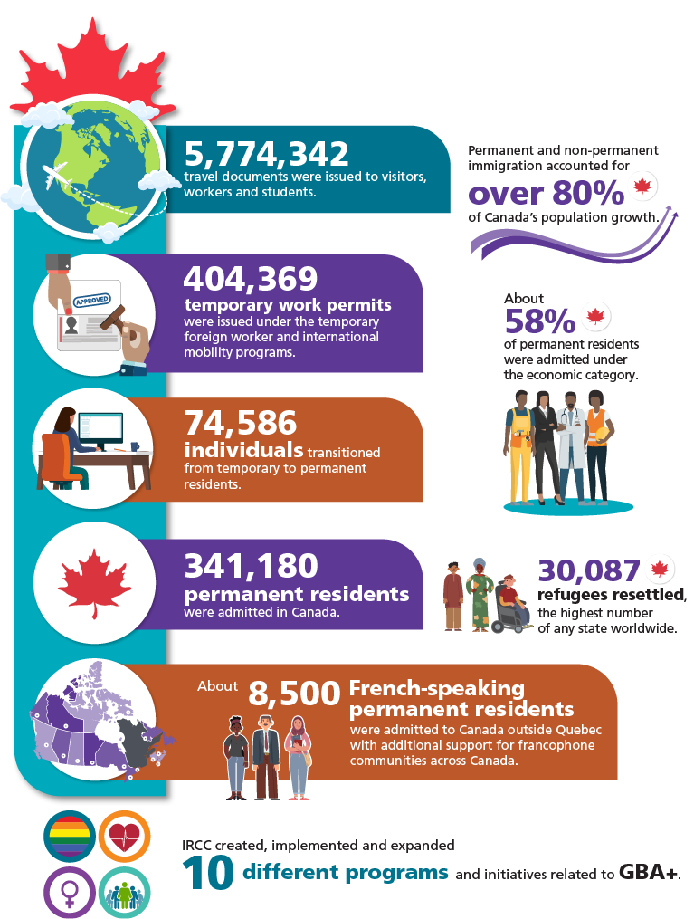
Who Are Regular Migrants to Canada?
A snapshot of immigration to Canada in 2019

Slide 7
Top 10 Source Countries in 2019
27,818
Philippines
85,593
India
10,121
Syria
10,793
Pakistan
6,056
Iran
7,030
Eritrea
10,780
USA
12,602
Nigeria
6,103
Korea
30,246
China
Notes:
In Total, the top 10 source countries account for 61% of all new permanent residents who arrived in Canada in 2019.
All other source countries account for 49% - Canada receives immigrants from 200 countries of origin.
Slide Genius – please change this list to the following top source countries:
India – 85,593
China – 30, 246
Phillipines – 27,818
Nigeria – 12, 602
Pakistan – 10,793
USA – 10,780
Syria – 10, 121
Eritrea – 7, 030
Korea – 6, 103
Iran – 6, 056

Slide 8
Health Care System
Canada has de-centralized, universal, publicly funded health system. Health care is funded and administered primarily by the provinces and territories.
Calgary Zone Primary Care Networks
All citizens and permanent residents receive medically necessary hospital and physician services free at the point of use.
Calgary Rural PCN
Calgary West Central PCN
Alberta health services provides for a large proportion of medical services: hospitals, acute care facilities, public health clinics.
South Calgary PCN
Bow Valley PCN
Primary care is delivered mainly by family physicians (about 50 percent of the doctors in Alberta) in private practices
Mosaic PCN
Calgary Foothills PCN
Primary Care Networks (PCNs)
Joint partnership between AHS and family physicians that reports to the ministry of health. They were developed as a way to bring family physicians together and promote innovations in coordinated primary care.
Highland PCN
Notes:
a large proportion of medical services (hospitals, acute care facilities, public health clinics) are delivered by Alberta Health Services (AHS)
Primary care is delivered mainly by family physicians (about 50 percent of the doctors in Alberta) in private practices. Primary Care Networks (PCNs) are a joint partnership between AHS and family physicians that reports to the Ministry of Health. They were developed as a way to bring family physicians together and promote innovations in coordinated primary care.
Slide Genius:
Are you able to simplify this slide to make it less wordy?
Can you add that temporary foreign workers have health coverage as long as they are employed and refugee claimants have health coverage through a special program funded by the Federal Government until their claim is either accepted, when they are then provided with provincial health coverage like all PRs, or their claim is rejected and they are expected to leave the country.
Undocumented migrants have no health coverage at all.

Slide 9
Health Care Coverage
Canadian Citizens and Permanent Residents have health services covered by the Provincial Government
Temporary foreign workers have health services covered by the Provincial Government but their coverage is contingent on their continued employment with their current employer
Refugee claimants have health services covered by the Federal Government until they are rejected/deported.
Undocumented migrants have no coverage for health services.

Slide 10
Same COVID-19 Storm but Different Socio-Economic Boats
Notes:
It has been said that COVID-19 places us in the same storm but different socio-economic boats in the way we can cope with it.
https://stock.adobe.com/ph/images/noahs-ark-in-a-storm-3d-illustration-mixed-media/263555389?prev_url=detail

Slide 11
Challenges For Covid Vaccination Of Migrants
Structural barriers
Limited access to information
Limited Health Literacy
Low Levels of Digital Literacy
Language Barrier
Transportation Barriers
Vaccine Hesitancy
Notes:
For the next 2 slides, could you come up with some sort of a visual representation for the content.

Slide 12
Opportunities For Covid Vaccination
Engagement with newcomer serving agencies
Vaccine educators and navigators (provide vaccine information is their same language, notify them when they become eligible for the vaccine, book them for their appointment, provide transportation if needed).
Engagement with ethnocultural community leaders and influencers
Vaccine champions
Engagement with primary care Vaccine education
Collaboration with newcomer serving agencies to facilitate access to vaccination for vulnerable newcomers.

Slide 13
conclusion
The Pandemic has forced the collaboration between Public Health, Primary Care, and Newcomer Serving Agencies to address inequities in health and help vulnerable migrants overcome barriers in access to health services, including the vaccination.
The promise for the future is that we can continue to strengthen these relationships in order to improve access to health services for vulnerable migrants in all areas of health.
Notes:
I wonder if we could use a picture of Noah’s Arc or something similar where we are all getting on the same boat to save us from the storm/flood.

Slide 14
The promise for the future
We can continue to strengthen these relationships between health, newcomer serving agencies, and community leaders in order to achieve equitable access to health for all migrants in Canada.
Notes:
Maybe we can use a picture of “Noah’s Arc” with sunrise on horizon to indicate getting out of storm and heading into sunnier days where all migrants have equitable access to care.

